Slide 1


PES's Modern College of Engineering, Pune-05
Department of Electronics and Telecommunication Engineering
AICTE Idea Lab
EnerGenius -Ultra-Low -Power Embedded
System Development Using MSPM0+
Faculty Coordinators
1
Dr.Mrs.V.P.Kodgirwar
Mr.A.R.Gangajaliwale

Slide 2

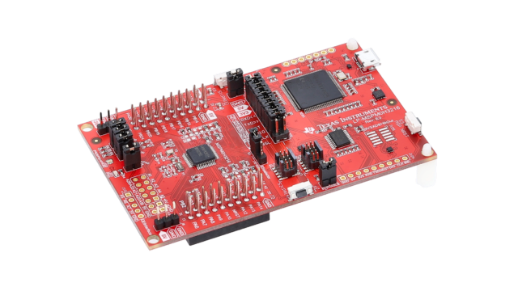
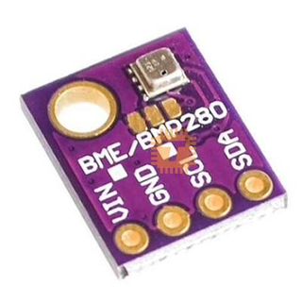
Smart Pressure & Altitude Monitoring System
Problem Statement 10
Description :
Design a pressure monitoring unit suitable for industrial process monitoring and portable instrumentation. The system continuously measures atmospheric or process pressure while operating in low-power mode.

Slide 3
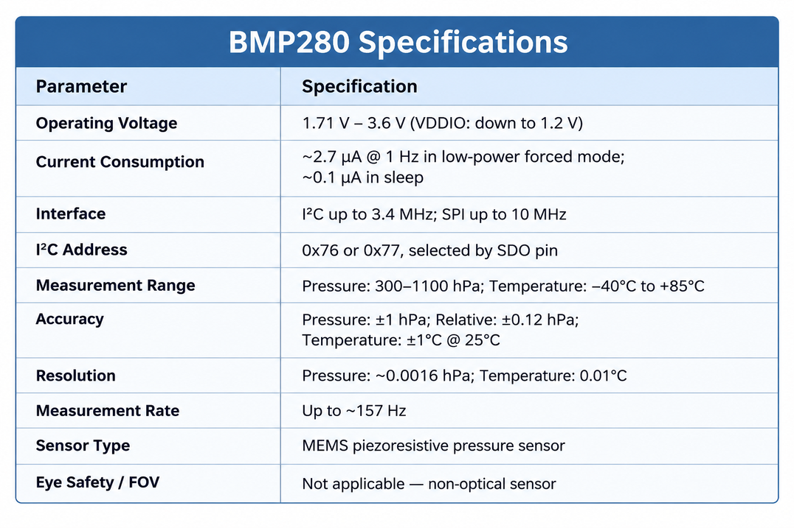
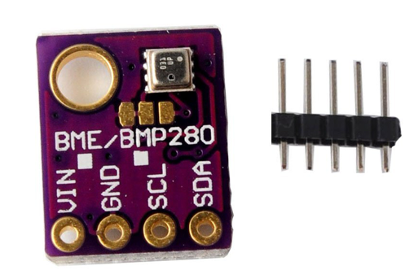
BMP280 Sensor Overview

Slide 4
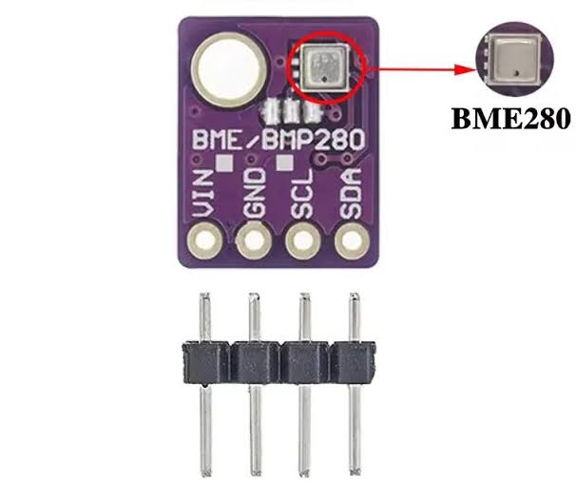
BMP280 Sensor Pin Functions
SDA - Serial Data Line
SCL- Serial Clock Line
GND - Ground
Vin - 3v3

Slide 5
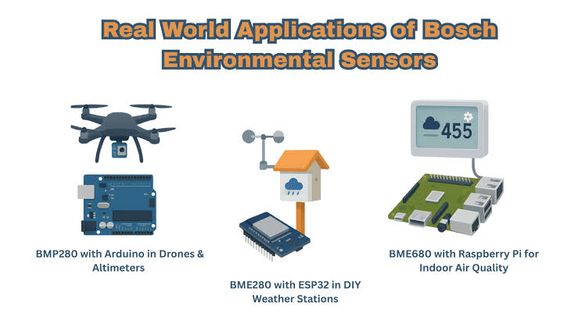
BMP280 Sensor Applications

Slide 6
BMP280 Sensor Applications
➢ Weather monitoring
Barometric pressure and temperature
➢ Altitude measurement
Estimate altitude from pressure
➢ Drones & robotics
Height and vertical-motion estimation
➢ Indoor navigation
Floor-level / elevation detection
➢ Smart devices
Compact pressure sensing in IoT
➢ HVAC systems
Air-pressure monitoring
➢ Wearables
Activity and elevation tracking
➢ Portable instruments
Digital barometer applications
➢ Environmental monitoring
Local atmospheric conditions
➢ IoT systems
Low-power pressure + temperature sensing
Typical BMP280 features: pressure range 300–1100 hPa • temperature sensing • I²C / SPI • low-power operation

Slide 7
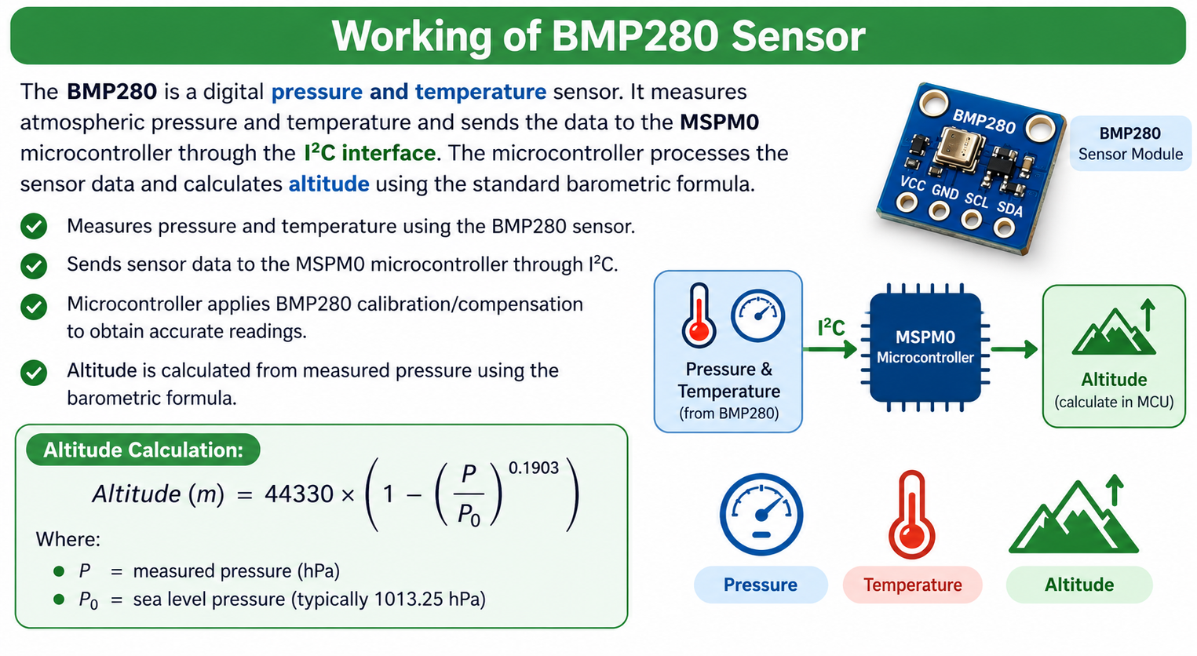
hectopascal

Slide 8
Working of BMP280 Sensor
◆ Step-by-Step Operation
1. Atmospheric Pressure
Pressure changes → MEMS diaphragm deflects
➢
Sensor detects changes in atmospheric pressure.
➢
MEMS diaphragm changes slightly with pressure.
2. Electrical Signal
Sensing element converts deflection
➢
Internal circuitry converts the change into an electrical signal.
➢
ADC digitizes the pressure and temperature signals.
3. ADC and Calibration
Digital conversion + calibration
➢
Calibration data is used to compensate the measurements.
➢
Pressure and temperature values are read through I²C or SPI.
4. Digital Output
Pressure & temperature via I²C / SPI

Slide 9
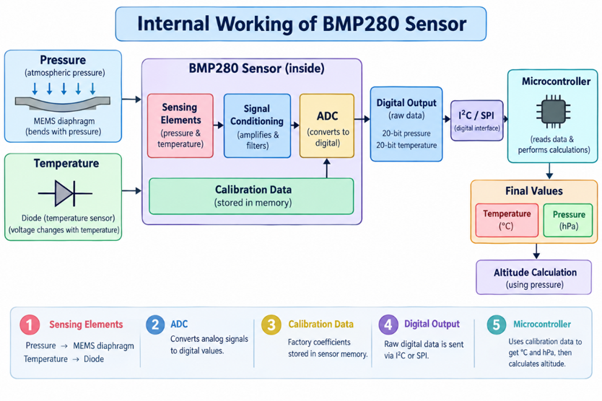

Slide 10
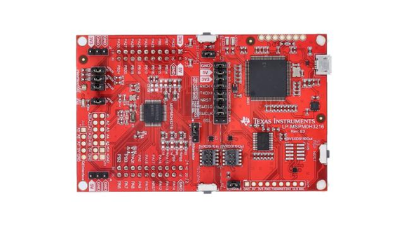
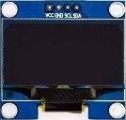

Pin connections Overview
SCL-PB2 SDA-PB3 VCC-Pin1 GND - Pin20
SCL-PB2 SDA-PB3 VCC-Pin1 GND - Pin20

Slide 11
Thought process to write code - Algorithm
  Initialize MSPM0 -Initialize GPIO, I²C and other required peripherals.Prepare the microcontroller for sensor and OLED communication.
  Initialize OLED- Configure and clear the OLED display.
  Detect and Initialize BMP280-Check the BMP280 at 0x76 and 0x77 addresses.Read calibration data and configure the sensor.
  Take First Sensor Reading- Read temperature and pressure from the BMP280.Calculate altitude and store these as reference values.
  Display Initial Values- Display pressure, temperature and altitude on the OLED.After a few seconds, turn the OLED OFF to save power.
  Enter Low-Power Mode-Start the timer and wait for the next sample using __WFI().The system wakes approximately every second.
  Check for Significant Change-Read the sensor values and compare them with reference values.Check temperature ≥10°C, pressure ≥10 hPa or altitude ≥20 m change.
  Update Display and Repeat-If a significant change occurs, turn ON the OLED and display new values.Update the reference values, turn OFF the OLED, and repeat monitoring.

Slide 12
Embedded C Code For Output
#define BMP280_ADDRESS_1 0x76
#define BMP280_ADDRESS_2 0x77
/* ====================================
* BMP280 REGISTERS
* ====================================
#define BMP280_REG_ID 0xD0
#define BMP280_REG_RESET 0xE0
#define BMP280_REG_CTRL 0xF4
#define BMP280_REG_CONFIG 0xF5
#define BMP280_REG_PRESS 0xF7
#define BMP280_REG_TEMP 0xFA
#define BMP280_REG_CALIB 0x88
/* ================================
* /* BMP280 calibration parameters */
* ============================== */
static unsigned short dig_T1;
static signed short dig_T2, dig_T3;
static unsigned short dig_P1;
static signed short dig_P2, dig_P3, dig_P4, dig_P5;
static signed short dig_P6, dig_P7, dig_P8, dig_P9;
static signed long t_fine;
#include "ti_msp_dl_config.h"
#include <math.h>
/* ======================================
* LOW-POWER MONITORING SETTINGS
* =======================================
#define TEMP_CHANGE_LIMIT 10.0f /* deg C */
#define PRESSURE_CHANGE_LIMIT 10.0f /* hPa */
#define ALTITUDE_CHANGE_LIMIT 20.0f /* meter */
#define OLED_DISPLAY_TIME 10 /* seconds */
/* SysTick is configured for 100 ms.
* Ten SysTick interrupts = approximately 1 second.
* MSPM0 SysTick period is limited, so do NOT use 32 MHz directly.
#define SYSTICK_PERIOD_TICKS 3200000UL
#define SYSTICK_TICKS_PER_SAMPLE 10U
volatile unsigned char sample_flag = 0;
volatile unsigned char systick_count = 0;
===================================
* I2C DEVICE ADDRESSES =====================================
#define OLED_ADDRESS 0x3C

Slide 13
======= DELAY FUNCTIONS === */
void delay_ms(unsigned int ms)
{
volatile unsigned int i, j;
for(i = 0; i < ms; i++)
{
for(j = 0; j < 3000; j++)
{
__NOP();
}
}
}
* ====== I2C COMMUNICATION ======== */
void I2C_Write2(unsigned char address,
unsigned char byte1,
unsigned char byte2)
{
unsigned char buffer[2];
buffer[0] = byte1;
buffer[1] = byte2;
while(!(DL_I2C_getControllerStatus(I2C1) &
DL_I2C_CONTROLLER_STATUS_IDLE));
DL_I2C_fillControllerTXFIFO(I2C1, buffer, 2);
);
while(DL_I2C_getControllerStatus(I2C1) &
DL_I2C_CONTROLLER_STATUS_BUSY_BUS);
}
/* ======== OLED FUNCTIONS ======= */
void OLED_Write(unsigned char control,
unsigned char data)
{
I2C_Write2(OLED_ADDRESS, control, data);
}
void OLED_Command(unsigned char command)
{
OLED_Write(0x00, command);
}
void OLED_Data(unsigned char data)
{OLED_Write(0x40, data);
}
void OLED_Wake(void)
{OLED_Command(0xAF);
}
void OLED_Sleep(void)
{OLED_Command(0xAE);
}

Slide 14
void OLED_Init(void)
{
delay_ms(100);
OLED_Command(0xAE);
OLED_Command(0x20);
OLED_Command(0x02);
OLED_Command(0xB0);
OLED_Command(0xC8);
OLED_Command(0x00);
OLED_Command(0x10);
OLED_Command(0x40);
OLED_Command(0x81);
OLED_Command(0x7F);
OLED_Command(0xA1);
OLED_Command(0xA6);
OLED_Command(0xA8);
OLED_Command(0x3F);
OLED_Command(0xD3);
OLED_Command(0x00);
OLED_Command(0x80);
OLED_Command(0xD9);
OLED_Command(0x40);
OLED_Command(0x8D);
OLED_Command(0x14);
OLED_Command(0xAF);
}
void OLED_DisplayPressure(float pressure)
{
OLED_SetCursor(0, 0);
OLED_String("P:");
OLED_Number((unsigned long)pressure);
}
void OLED_DisplayTemperature(float temperature)
{
OLED_SetCursor(2, 0);
OLED_String("T:");
OLED_SignedNumber((long)temperature);
OLED_Char('C');
}
void OLED_DisplayAltitude(float altitude)
{
OLED_SetCursor(4, 0);
OLED_String("A:");
OLED_SignedNumber((long)altitude);
OLED_Char('M');
}
/* ====== BMP280 I2C READ ======= */
void BMP280_ReadBytes(unsigned char reg,
unsigned char *data,
unsigned int length)
{
unsigned int i;
while(!(DL_I2C_getControllerStatus(I2C1) &
DL_I2C_CONTROLLER_STATUS_IDLE));
DL_I2C_fillControllerTXFIFO(I2C1, &reg, 1);
DL_I2C_startControllerTransfer(
I2C1,
bmp280_address,
DL_I2C_CONTROLLER_DIRECTION_TX,1
);
while(DL_I2C_getControllerStatus(I2C1) &
DL_I2C_CONTROLLER_STATUS_BUSY_BUS);
DL_I2C_startControllerTransfer(
I2C1,
bmp280_address,
DL_I2C_CONTROLLER_DIRECTION_RX,
length
);
for(i = 0; i < length; i++)
{
while(DL_I2C_isControllerRXFIFOEmpty(I2C1));
data[i] =
DL_I2C_receiveControllerData(I2C1);
}

Slide 15
unsigned char BMP280_ReadRegister(unsigned char reg)
{
unsigned char data;
BMP280_ReadBytes(reg, &data, 1);
return data;
}
/* ====== BMP280 DETECTION ========= */
unsigned char BMP280_Detect(void)
{
unsigned char id;
bmp280_address = BMP280_ADDRESS_1;
id = BMP280_ReadRegister(BMP280_REG_ID);
if(id == 0x58 || id == 0x56 || id == 0x57)
return 1;
bmp280_address = BMP280_ADDRESS_2;
id = BMP280_ReadRegister(BMP280_REG_ID);
if(id == 0x58 || id == 0x56 || id == 0x57)
return 1;
return 0;
}
* ========== CALIBRATION ==== */
void BMP280_ReadCalibration(void)
{
unsigned char c[24];
BMP280_ReadBytes(BMP280_REG_CALIB, c, 24);
dig_T1 = ((unsigned short)c[1] << 8) | c[0];
dig_T2 = ((signed short)c[3] << 8) | c[2];
dig_T3 = ((signed short)c[5] << 8) | c[4];
dig_P1 = ((unsigned short)c[7] << 8) | c[6];
dig_P2 = ((signed short)c[9] << 8) | c[8];
dig_P3 = ((signed short)c[11] << 8) | c[10];
dig_P4 = ((signed short)c[13] << 8) | c[12];
dig_P5 = ((signed short)c[15] << 8) | c[14];
dig_P6 = ((signed short)c[17] << 8) | c[16];
dig_P7 = ((signed short)c[19] << 8) | c[18];
}
/* ====== BMP280 INITIALIZATION ========= */
void BMP280_Init(void)
{
BMP280_WriteRegister(
BMP280_REG_CONFIG, 0x08
);
BMP280_WriteRegister(
BMP280_REG_CTRL,0x27 );
delay_ms(100);
}

Slide 16
/* ======= TEMPERATURE ======== */
float BMP280_ReadTemperature(void)
{
long raw_T;
signed long temperature;
raw_T = BMP280_ReadRawTemperature();
temperature =BMP280_CompensateTemperature(raw_T);
return ((float)temperature / 100.0f);
}
/* ========= PRESSURE ========== */
float BMP280_ReadPressure(void)
{
long raw_P;
unsigned long pressure;
raw_P = BMP280_ReadRawPressure();
pressure =BMP280_CompensatePressure(raw_P);
return ((float)pressure / 100.0f);
}
/* =========== ALTITUDE ========= */
float BMP280_CalculateAltitude(float pressure_hPa)
{
const float P0 = 1013.25f;
if(pressure_hPa <= 0.0f)
return 0.0f;
return 44330.0f *(1.0f -powf(pressure_hPa / P0, 0.1903f));
}
/* ====== MAIN PROGRAM ======= */
int main(void)
{
float temperature;
float pressure;
float altitude;
float old_temperature;
float old_pressure;
float old_altitude;
SYSCFG_DL_init();
/* Initialize OLED */
OLED_Init();
OLED_Clear();
/* Detect BMP280 */
if(BMP280_Detect() == 0)
{
OLED_DisplayBMP_ERROR();
while(1)
{
__WFI();
}
}
/* Read calibration data */
BMP280_ReadCalibration();
/* Initialize BMP280 */
BMP280_Init();
/* First sensor reading */
temperature = BMP280_ReadTemperature();
pressure = BMP280_ReadPressure();
altitude =
BMP280_CalculateAltitude(pressure);
old_temperature = temperature;
old_pressure = pressure;
old_altitude = altitude;
/* Display initial values */
OLED_DisplayPressure(pressure);
OLED_DisplayTemperature(temperature);
OLED_DisplayAltitude(altitude);
delay_ms(5000);
/* Turn OLED OFF */
OLED_Sleep();
{
while(sample_flag == 0)
{
__WFI();
}

Slide 17
{
/* Wake OLED */
OLED_Wake();
OLED_Clear();
/* Display new values */
OLED_DisplayPressure(pressure);
OLED_DisplayTemperature(temperature);
OLED_DisplayAltitude(altitude);
/* Update reference values */
old_temperature = temperature;
old_pressure = pressure;
old_altitude = altitude;
/* Display for fixed time */
delay_ms(OLED_DISPLAY_TIME * 1000);
/* Turn OLED OFF */
OLED_Sleep();
}
}
}
sample_flag = 0;
/* Read sensor */
temperature =BMP280_ReadTemperature();
pressure =BMP280_ReadPressure();
altitude =BMP280_CalculateAltitude(pressure);
/* Check significant change */
if((fabsf(temperature - old_temperature)>= TEMP_CHANGE_LIMIT) ||
(fabsf(pressure - old_pressure)>= PRESSURE_CHANGE_LIMIT) ||
(fabsf(altitude -old_altitude)>= ALTITUDE_CHANGE_LIMIT))

Slide 18
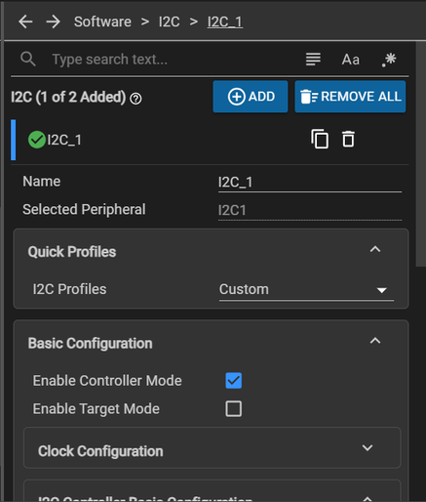
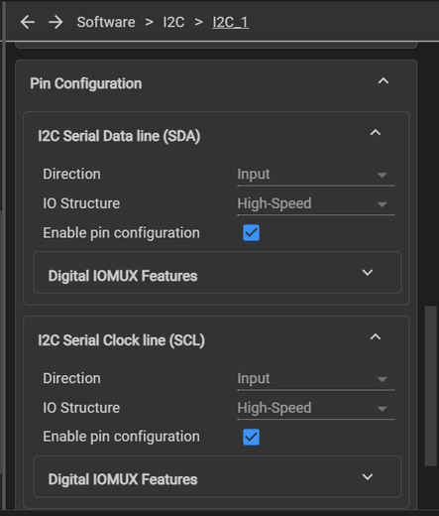
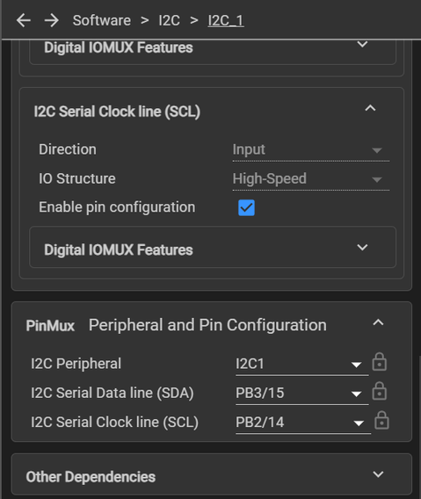
system configuration :

Slide 19
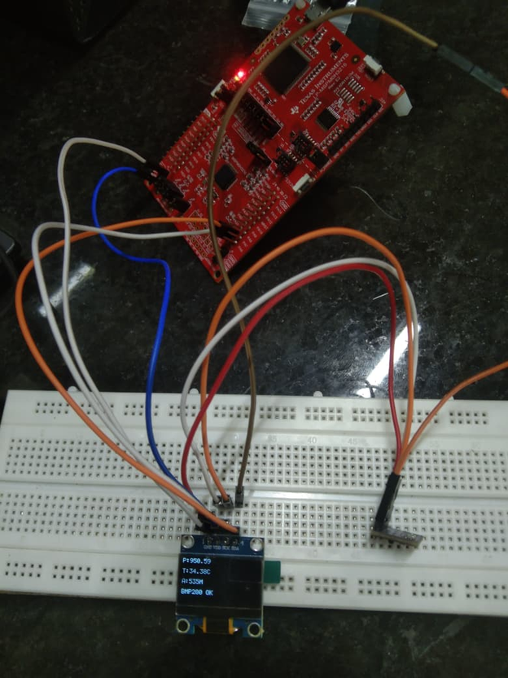
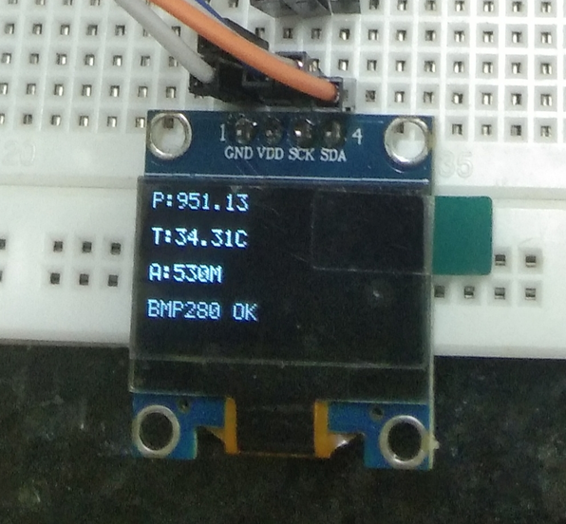
Practical Implementation Of Pressure & Altittude Moniter

Slide 20


